Slide 1
Introduction to the tort of negligence

Slide 2
1. What is Tort Law?
A common law civil wrong, excluding breach of contract.
Characteristics:
  (Generally) No need for a pre-tort relationship
    [duties imposed by law, ie not by the State (criminal law) or by individuals following negotiation (contract law)]
  Generally, protect claimant’s rights and interests
    [protective function]
  Remedies: chief remedy is compensatory damages – restore status quo ante/restitutio in integrum
    [ie attempts to put Claimant in pre-tort position]

Slide 3
2. In practice: terms used
Claimant
Defendant
Tortfeasor

Slide 4
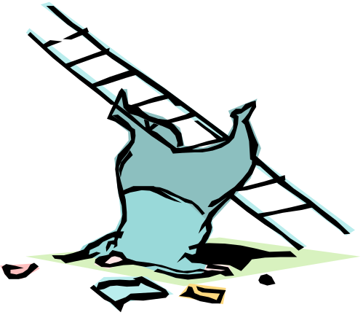
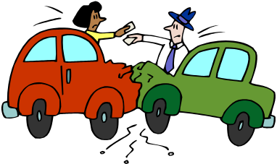
3. Negligence
Breach of the duty to take reasonable care not to harm another’s protected interests
ie requires carelessness (fault) & damage
But, only actionable where a duty of care exists, owed by the defendant to the claimant

Slide 5
4. Essential components of the tort of negligence
1. A duty is owed by the tortfeasor (usually the defendant), to the claimant (duty)
2. The duty is breached: conduct falls below the required standard of care (breach)
3. The breach of duty causes damage (damage/causation)
That damage is not too remote from the breach, ie actionable (remoteness)
*Only actionable if all 4 are present*

Slide 6
5. The importance of the duty of care
Negligence in the abstract does not lead to liability …
There must be a breach of a duty of care owed by the tortfeasor to the claimant
    [That breach of duty must also cause actionable damage, which is not too remote (i.e. causation & remoteness)]

Slide 7

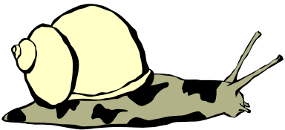
Key case: Donoghue v Stevenson
Two very important steps taken:
Independence of tort from contract; tort allowed to operate beyond the limits of contract (‘privity’) (Lord Macmillan)
    Remember ‘privity’ in contract?
2. Unification of negligence through the ‘neighbour principle’ (Lord Atkin)

Slide 8
Lord Atkin’s neighbour principle
‘Who in law is my neighbour?’
Those so closely and directly affected that I ought to have them in contemplation
Only applies where there is ‘proximity’: not only physical proximity, but close and direct relations
Here: consumer in ‘close and direct’ relations with manufacturer, where no opportunity to inspect (NB opaque bottle)

Slide 9
The role played by duty of care
In recent years, the role played by the duty of care is a limiting one: no liability for negligence unless there is a duty to take care
This is important: carelessness is an ordinary part of life, and damage is often foreseeable, on reflection.

Slide 10
6. The concept of ‘Duty of Care’
Imposed by law.
Current approach: Positive justification is needed for shifting the risk of damage to D; i.e., ‘what is there about this relationship which justifies a duty to take care’?
See Caparo v Dickman (1990)

Slide 11
The present position: positive justification required
Caparo v Dickman moved English law to requiring positive justification for a duty of care in each case.
Note though that some established categories are entirely straightforward – except perhaps as to the kinds of damage which might be included.
Doctors-patients; drivers-other road users; employers-employees: duties clearly exist, but what are their range? (mental/economic harm?)

Slide 12
7. The current duty of care test: Caparo v Dickman
Three ‘ingredients’ for the test. All are of equal importance:
Foreseeability
‘Proximity’
Is the duty ‘fair just and reasonable’?
(The last of these is directly related to consideration of the impact of liability)

Slide 13
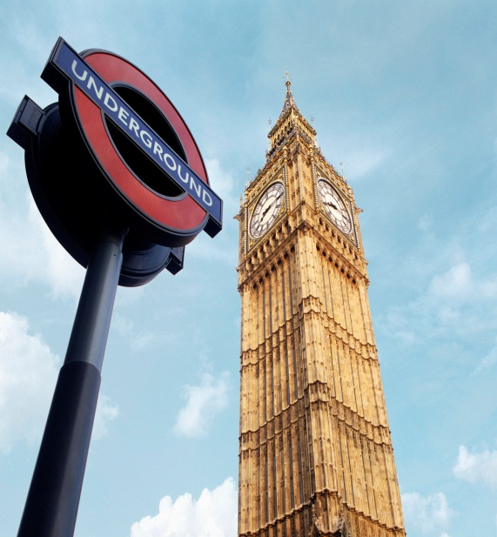
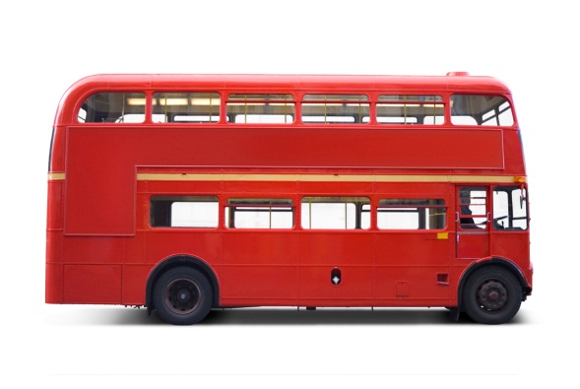
8. Breach - the basic standard: the reasonable person
ie How to recognise ‘negligence’
The standard is that of ‘the reasonable person’;
This test is therefore objective: it is not a question of what the particular individual would have done in the circumstances;
However, it is subject
to some variations

Slide 14

The objective standard
Nettleship v Weston: Learner driver held to
standard of ordinary experienced driver
Why?
1. Expectations: we can expect a particular standard of safety from all other road users
2. Uniformity: duty cannot vary depending on what the claimant knows about defendant
3. Compensation issues: learner was insured for tort liability; not many people have first party insurance; therefore best to ‘see to it’ that there is liability

Slide 15
Variations: which ‘reasonable person’?
Though objective, the standard may vary with circumstances; and with the broad nature of the person or task
Circumstances
‘The heat of the moment’: emergency vehicles and rescuers; sporting events
Blake v Galloway: (friends throwing twigs at each other) it is partly the need to act quickly and partly the legitimate expectations of consenting participants; that justify the variations in standard

Slide 16
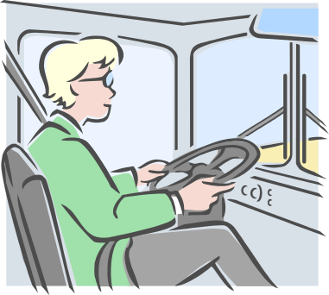
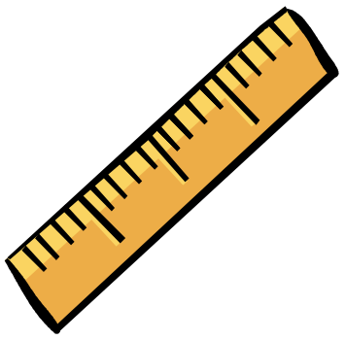
Variations to the standard:
People - capacity
Mansfield v Weetabix: driver with unknown medical condition exonerated. Is this correct?
Children
Held to the standard of ‘the reasonable child’ of their age. (Mullin v Richards).

Slide 17
Skilled defendants
A skilled person ‘professing to have a special skill’ is held to the standard of a person exercising that skill.
Lack of experience in the post is not an excuse: Wilsher v Essex AHA (CA)

Slide 18
Example: variation with task, not with level of experience
Mustill LJ, Wilsher v Essex AHA
‘To my mind, this notion of a duty tailored to the actor, rather than to the act which he elects to perform, has no place in the law of tort’.
NB ‘legitimate expectation of the patient’ that s/he will receive a certain standard of care

Slide 19
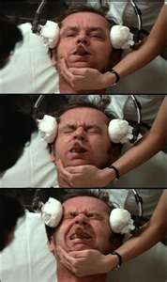
9. How to judge ‘negligence’ by a skilled professional?
NB this concerns the assessment of
the defendant’s conduct.
Bolam v Friern Hospital:
No negligence if ‘he has acted in accordance with a practice accepted as proper by a responsible body of medical men skilled in that particular art’

Slide 20
10. Reasonable risk-taking
It is not always ‘unreasonable’ to impose a risk on others. In the tort of negligence, only unreasonable action attracts liability.

Slide 21
Causation and context:
R v Kennedy [2007] UKHL 38
15. Questions of causation frequently arise in many areas of the law, but causation is not a single, unvarying concept to be mechanically applied without regard to the context in which the question arises.

Slide 22
11. Causation/ ‘Cause in Fact’
The main technique is to ask what would have happened ‘but for’ the breach of duty.
There is no need to be the cause; sufficient to be a cause
If the injury would still have happened but for the breach, the ‘but for’ test is not passed. (Carelessness ‘made no difference’/‘did not cause’ the harm)

Slide 23

Examples
Barnett v Chelsea Hospital
Arsenic poisoning. Even speedy attention would not have saved C’s life.
[NB this assessed on balance of probabilities]
Bolitho: even if D had attended, would not
have intubated …

Slide 24
12. Some deficiencies of the ‘but for’ test
Multiple causes
  How to divide responsibility where there is more than one cause?
Un-provable causal factors
  Science cannot prove which person/exposure caused the damage, e.g. mesothelioma

Slide 25
Basic principle: consecutive torts
Each tortfeasor should be liable only for the damage they caused: wholly different from joint tortfeasors
If the claimant was already ‘damaged’ by D1, D2 pays only for additional harm
D1’s responsibility for the initial injury continues after second tort. Otherwise, there would be under-compensation, or excessive liability for D2
Importantly, C must pursue each tortfeasor to achieve full compensation

Slide 26
Proof of causation
The basic principle
All questions of proof in tort are settled ‘on the balance of probabilities’.
Putting this in numerical/percentage terms, causation is proved if there is a likelihood of greater than 50% that the breach caused the damage.

Slide 27
13. What is ‘remoteness’?
1. The historic approach: Re Polemis
Damage ‘not too remote’ because it was a direct consequence of the tort
2. The Wagon Mound approach
Damage was ‘too remote’ because the kind of damage was unforeseeable.

Slide 28
The Wagon Mound: foreseeability
The question: whether the damage is of such a kind that a reasonable man [sic] should have foreseen.
The goal: to avoid the ‘never-ending and insoluble problems of causation’.
Replaces causal (factual) question with a legal question, about foreseeability; not a question of science or philosophy.

Slide 29
The Wagon Mound cont
What has to be foreseeable?
Not the ‘extent’ of the damage, but the ‘kind’ of damage.
Note the importance of the way in which ‘kind of damage’ is defined.
The ‘kind’ of damage and not the way in which it came about?

Slide 30
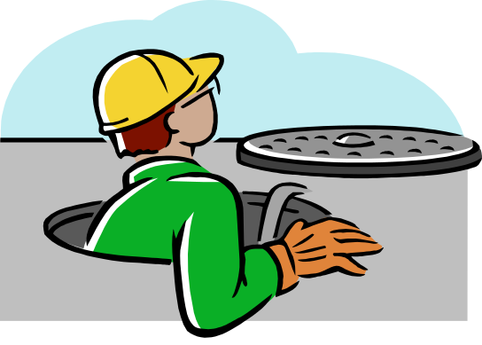

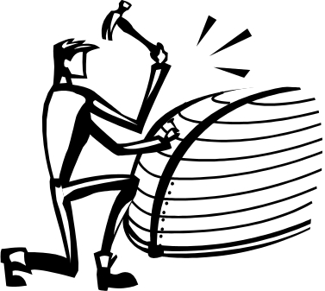
Chain of events
Hughes v Lord Advocate (1963): known source of danger, unforeseen events and extent of damage: satisfied the ‘foreseeability’ test
Jolley v Sutton (2000): foreseeability requires ‘intense focus on the facts’ (Lord Steyn)?
Lord Hoffmann: is the injury of a description which was reasonably foreseeable?
And, what is the risk against which D should have guarded?
Notes:
Hughes: A manhole in an Edinburgh street was opened under statutory powers for the purpose of maintaining underground telephone equipment. It was covered with a tent and, in the evening, left by the workmen unguarded but surrounded by warning paraffin lamps. An eight-year-old boy entered the tent and knocked or lowered one of the lamps into the hole. An explosion occurred causing him to fall into the hole and to be severely burned:-
Held, that the workmen were in breach of a duty of care to safeguard the boy against this type of occurrence which, arising from a known source of danger, the lamp, was reasonably foreseeable, although that source of danger acted in an unpredictable way
Jolley:A boat was left abandoned for at least two years beside a block of flats on land owned by the defendant council. The council was aware of the boat's presence and made plans to remove it, but they were not implemented. It appeared to be sound but was in fact rotten. Two boys, the plaintiff and a friend, who were aged 14 and 13, started to repair the boat, using a car jack and some wood to prop it up. While the boys were working on the boat it fell off the prop, crushing the plaintiff, who suffered serious spinal injuries resulting in paraplegia with major complications. He brought an action against the council for damages in negligence and breach of statutory duty under the Occupiers' Liability Act 1957.¹ The judge held, giving judgment for the plaintiff but reducing the damages by 25 per cent. by virtue of a finding of contributory negligence, that the presence of the boat would attract children and that the type of accident and injury that occurred was reasonably foreseeable

Slide 31
The Wagon Mound cont
How is ‘foreseeability’ judged?
From the point of view of a reasonable person in the position of D at the time of the tort: foreseeability in a practical sense
Not with hindsight, referring to the exact chain of events: specific foreseeability

Slide 32
14. Persisting issues: ‘Novus Actus interveniens’
What if a ‘new intervening act’ or ‘intervening cause’: breaks the ‘chain of causation’.
Can ‘novus actus’ cases be addressed without reference to causal ideas?

Slide 33
Intervening acts of third parties
There may be liability in some cases where a third party act is involved in the chain of events that brings about damage.
D may have created the conditions which allow the third party to cause damage; or
D may have omitted to act to control or prevent the damage

Slide 34
Stansbie v Troman
Contractor left alone in house and given key
Went out leaving the house unlocked
Liable for effects of a break-in: under a duty to lock the door to avoid this very kind of thing

Slide 35
‘Novus actus’ by claimant?
McKew:
Foolish decision to come downstairs without a handrail was a novus actus: responsible for own further injuries.
Notes:
The appellant sustained injury in the course of his employment for which the respondents were liable. As a result, on occasions, he unexpectedly lost control of his left leg which gave way beneath him. He would have recovered within a week or two but for a second injury which he suffered. On leaving a flat, accompanied by his wife and child and brother-in-law his leg collapsed as he made to descend some steep stairs where there was no handrail (his wife and brother-in-law were at the time securing the door). The appellant pushed his daughter aside to avoid pulling her down the stairs and himself tried to jump so that he would land in a standing position rather than falling over down the stairs. On landing he suffered a severe fracture of the ankle. On the question whether the respondents were liable for the injuries caused by the second accident

